Slide 1
Store Sales Prediction
Arshad Shaikh

Slide 2
Objective –
To create a web application that can predict the store sales by analysing Stores Sales data on basis of Item and Outlet data.
Benefits –
Correct prediction of sales data helps in estimating customer demand.
Helps improve companies financial performance.
Instant availability of products attracts customers and helps in business growth.

Slide 3
Data Sharing Agreement –
Number of Columns
Column Names
Column Data Types
Columns with Null Values

Slide 4
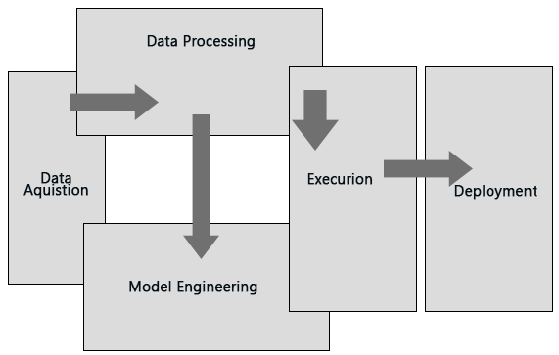
Diagram
Architecture -

Slide 5
Data Insertion Into Database –
All the valid and invalid data are uploaded to MongoDB database with a table name that consists of the file type(valid/invalid) and a timestamp.
The valid data is used for model training.
The invalid data is used for further audit.

Slide 6
Model Training:
Data Export from Db -
The accumulated data from db is exported in csv format for model training
Data Preprocessing -
Performing EDA to get insight of data like identifying distribution , outliers ,trend among data etc.
Check for null values in the columns. If present impute the null values.
Encode the categorical values with numeric values.
Perform Standard Scalar to scale down the values for Linear, Lasso and Ridge Regression.

Slide 7
Model Building -
We will use Random Forest Regressor as the base model and use GridSearchCv for Hyperparameter Tuning. The model with the highest R2 score is selected.
Prediction:
The testing files are shared in the batches and we perform the same Validation operations ,data transformation and data insertion on them.
The accumulated data from db. is exported in csv format for prediction
We perform data pre-processing techniques on it and then perform predictions.
Once the prediction is done for all the clusters. The predictions are saved in csv format and shared.

Slide 8
Deployment -
The application is hosted on AWS (Amazon Web Services)

Slide 9
FAQ
Q 1) What is the source of data?
Ans. The data was taken from Kaggle.
Link - https://www.kaggle.com/brijbhushannanda1979/bigmart-sales-data
Q 2) What was the type of data?
Ans. The data was a combination of numerical and categorical values.
Q 3) What’s the complete flow you followed in this Project?
Ans. Refer to the software architecture document.

Slide 10
Q 5) How logs are managed?
Ans. The logs are uploaded in current working directory
Q 6) What techniques were you using for data pre-processing?
Removing unwanted attributes
Cleaning data and imputing if null values are present.
Converting categorical data into numeric values.
Scaling the data
Q 7) How training was done or what models were used?
Ans. Scaling was performed upon training and validation set. Then they were passed to Random Forest Regressor. We used Grid Sesrch Cv for hypermparameter tuning.
Q 8) How Prediction was done?
Ans. The testing files will be uploaded by the end user and if they pass all validation checks, prediction will be done.

